Slide 1
Fourier Analysis
Ajit Rajwade

Slide 2
Fourier Analysis
Discovery by the French Mathematician Joseph Fourier.
Motivated initially from thermodynamics (heat equation).
Fundamental to modern signal and image processing (particularly in image or signal filtering).
Also very widely used in optics, probability theory, solutions of partial differential equations and many other areas of mathematics.

Slide 3
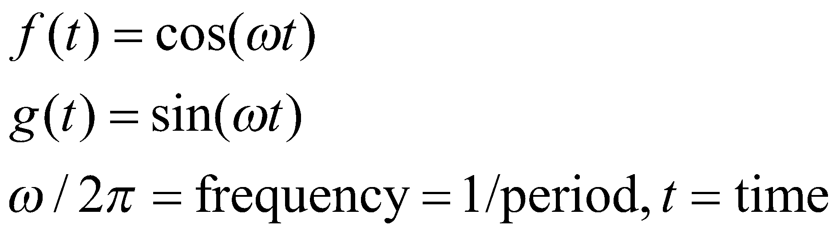
Fourier Series
Any periodic function can be represented accurately as the linear combination of sine and cosine signals of different frequencies.
This is called the Fourier series.
The sinusoidal signals are given as:

Slide 4
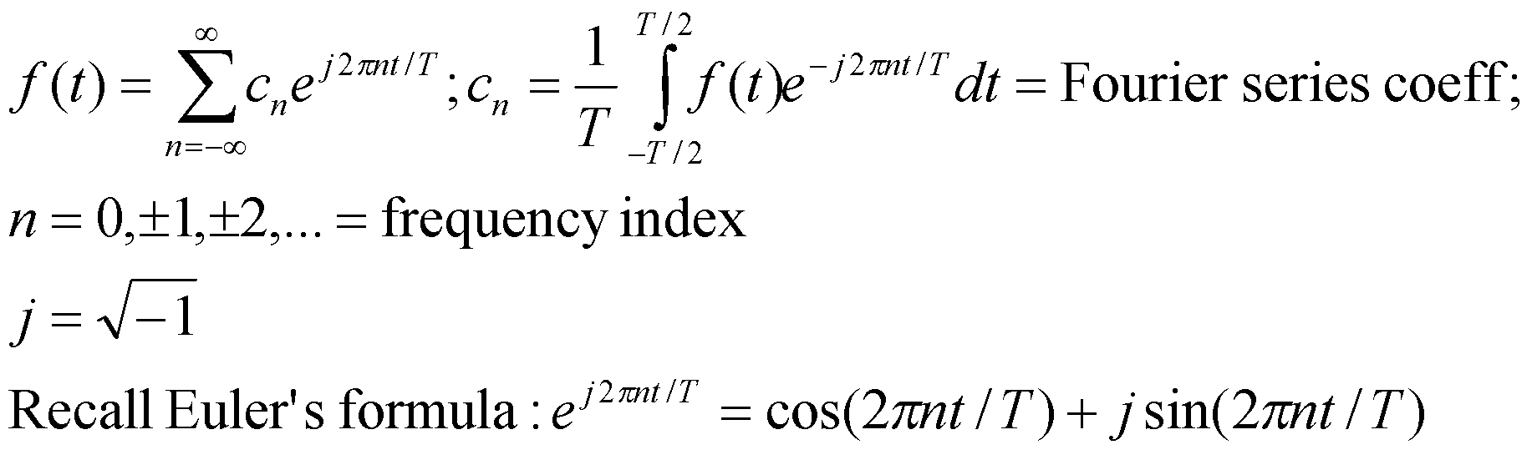
Fourier Series
The Fourier series for a signal f(t) with period T is given as follows:
How do you justify the formula for c_{n}?

Slide 5
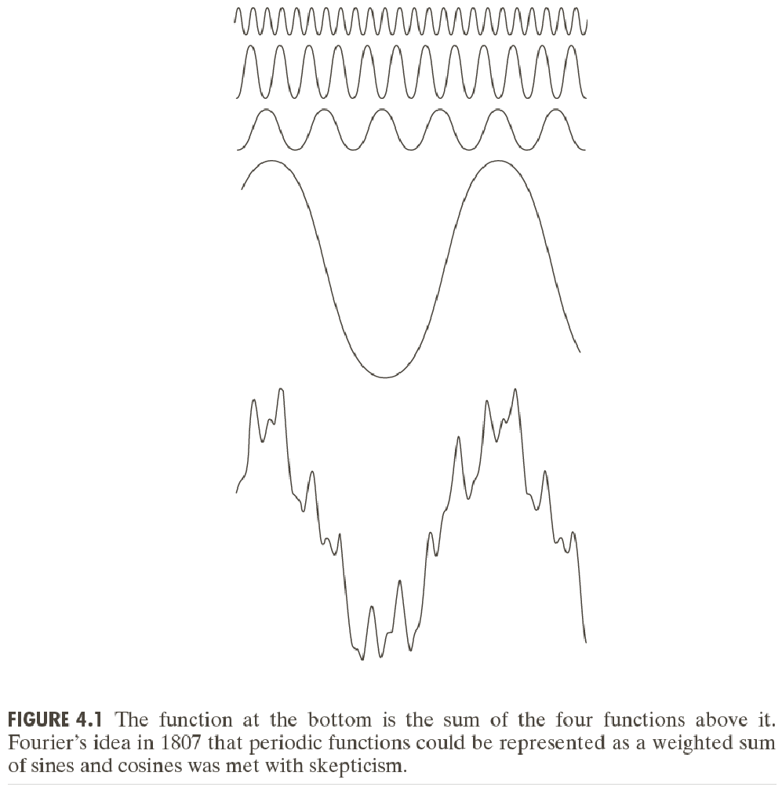

Slide 6
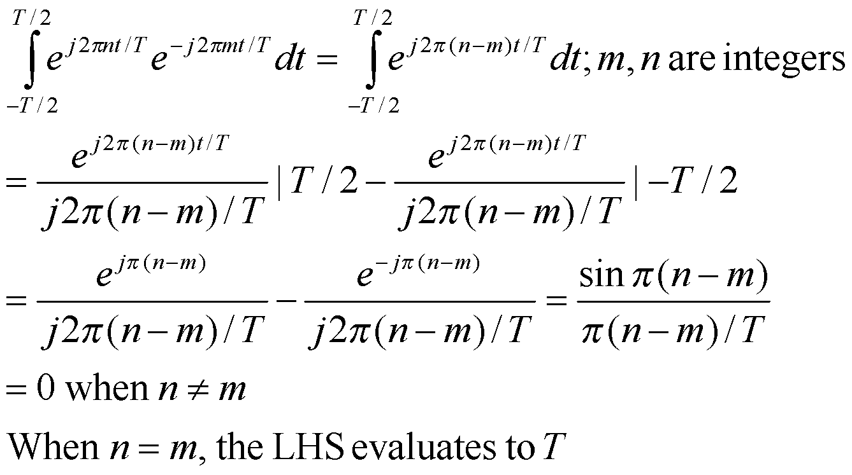
Fourier Series
It follows from the following trigonometric identity:

Slide 7
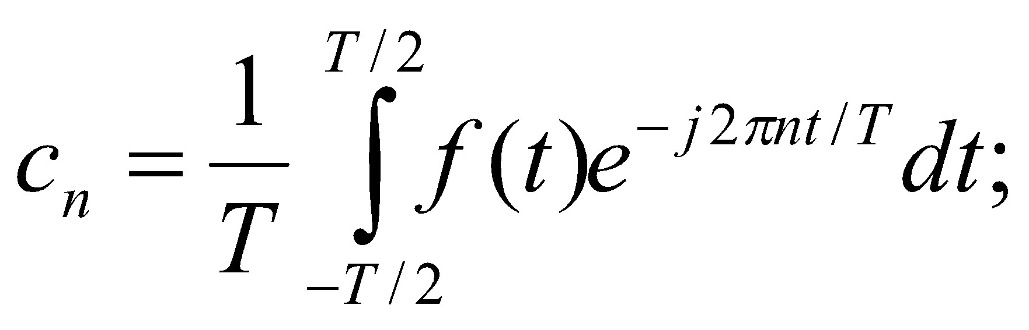
Fourier Series
Given a signal f(t), how do we obtain its Fourier series coefficients?
To find the coefficient at frequency 2πn/T, we compute the following integral:

Slide 8
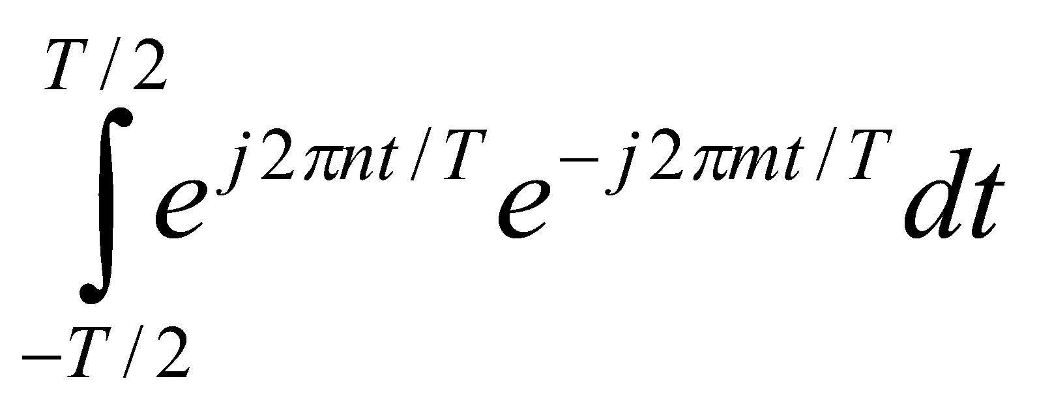
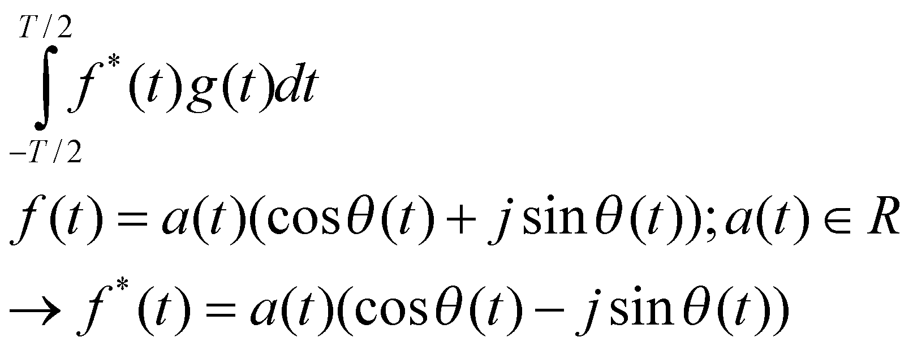
Fourier Series
Consider integral of the following form:
The inner product between two periodic complex valued functions f and g is given as:

Slide 9
Fourier Series
In computing Fourier series coefficients, we are considering inner products of complex sinusoidal signals of different frequencies.
When the frequencies are different, the inner product is 0.
When the frequencies are the same, the inner product is T.
Any signal can be represented using these sinusoidal signals – giving rise to an orthogonal basis.

Slide 10
Function s(t) (in red) is a sum of six sine functions of different amplitudes
and harmonically related frequencies. Their summation is called a Fourier series.
https://en.wikipedia.org/wiki/Fourier_series#/media/File:Fourier_series_and_transform.gif

Slide 11
Why complex exponentials?
We need complex exponentials as they consist of both sines and cosines.
Only sine signals cannot represent shifted sine waves or cosine waves completely.

Slide 12
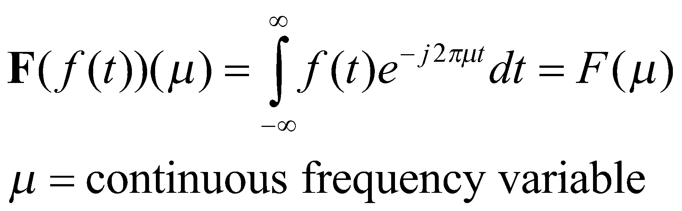
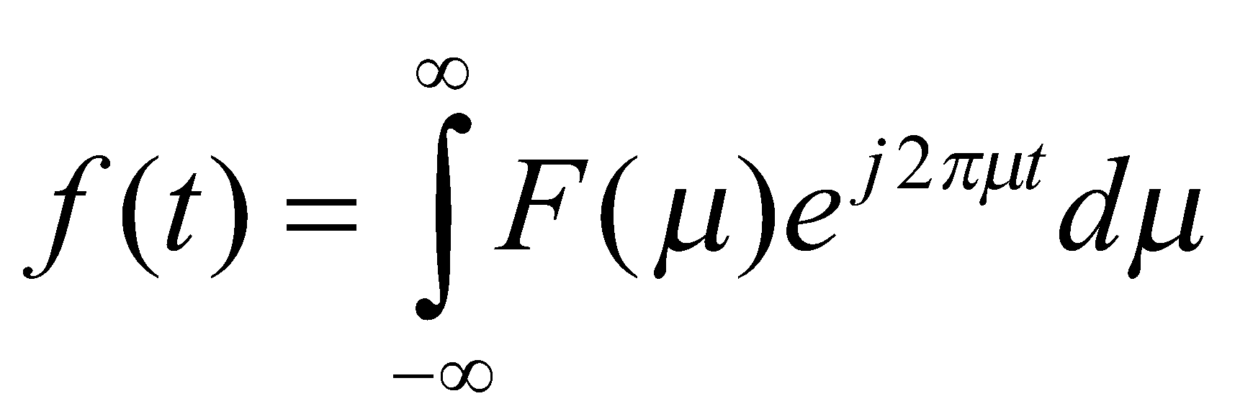
Fourier transform
Extension of Fourier series to non-periodic but absolutely integrable or square integrable signals.
Mathematically given as follows:
We also have:
These formulae are consistent, due to the orthogonality of the sinusoidal functions.

Slide 13
Fourier Transform
F(µ) is the Fourier coefficient at frequency µ, computed by integrating out the time variable t.
The original signal can be reconstructed accurately (without loss of information) from its Fourier coefficients by integrating out the frequency variable.
Thus a signal and its Fourier transform (the set of all its Fourier coefficients) form a unique “Fourier pair”.
Convention: Time-domain signals are denoted in lower case (eg: f(t)), whereas their Fourier transforms are denoted in upper case (F(µ)).
The Fourier operator is denoted by F (bold font) to distinguish it from the Fourier transform of f.

Slide 14
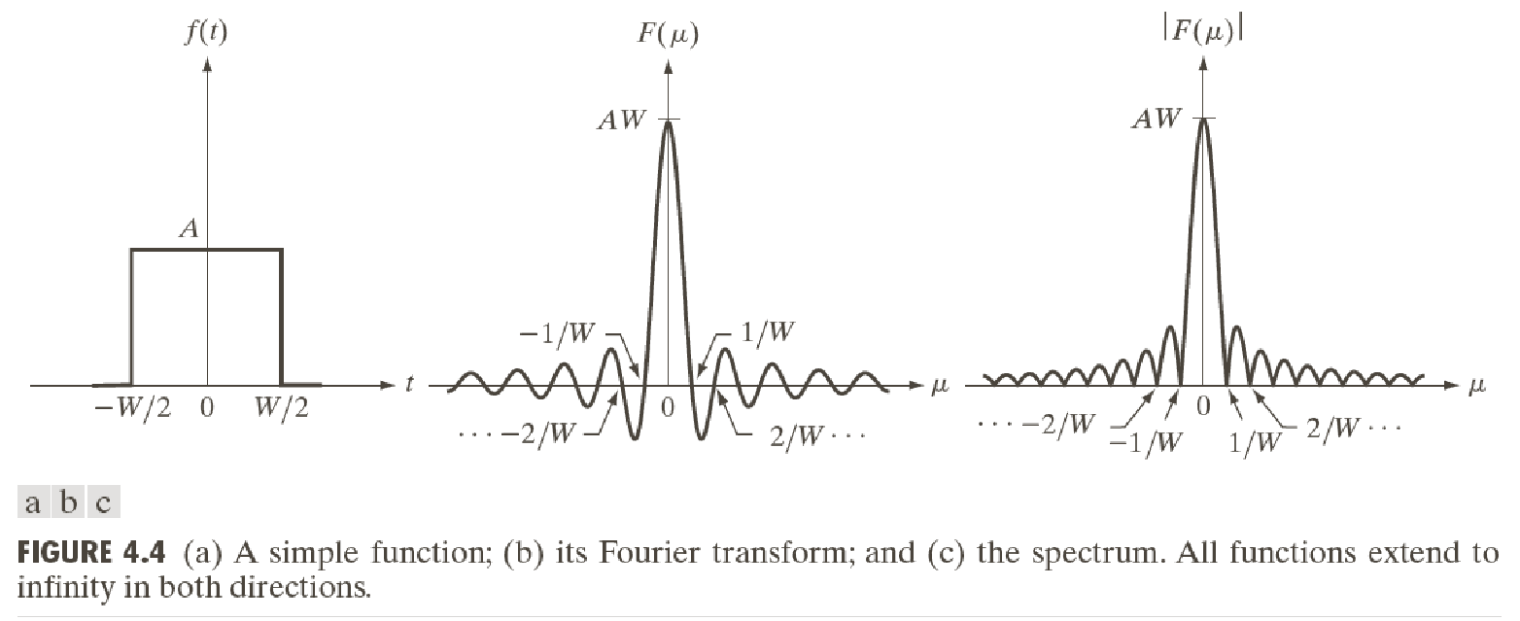
Example 1: Rect and sinc

Slide 15
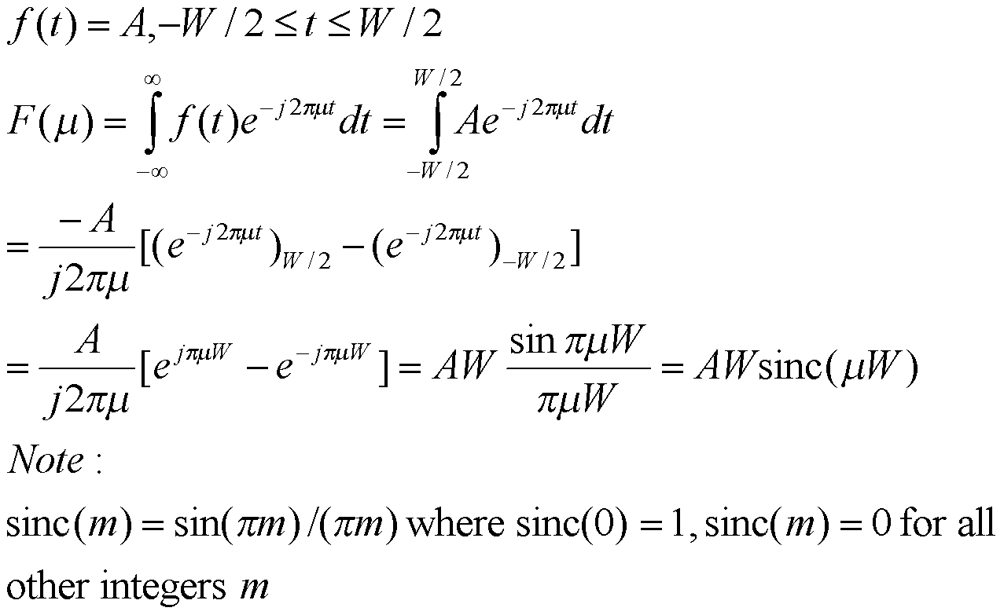
Example 1: Rect and sinc
It also turns out that the Fourier transform of a sinc in the time domain is a rect in the frequency domain. This has a much more complicated proof.

Slide 16
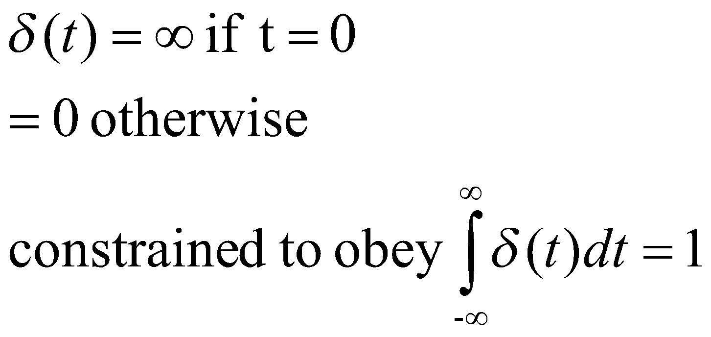
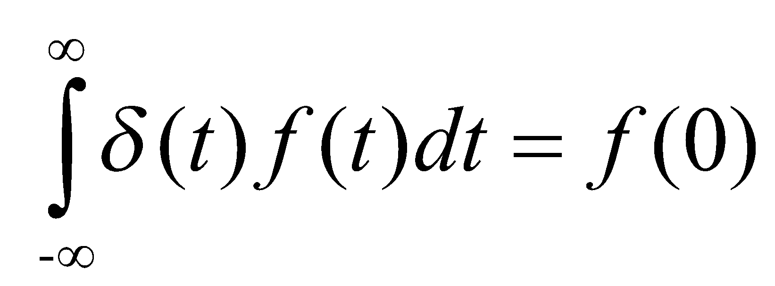
Example 2: Delta Functions
The Dirac Delta or the unit impulse signal with continuous variable t is defined as follows:
Sifting property:

Slide 17
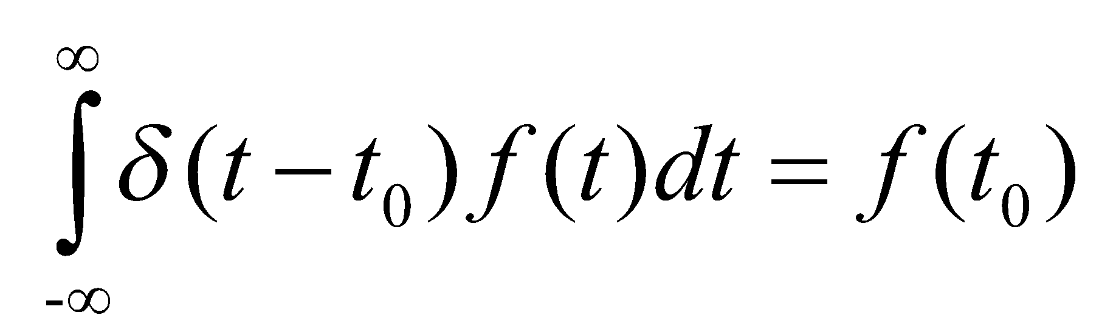
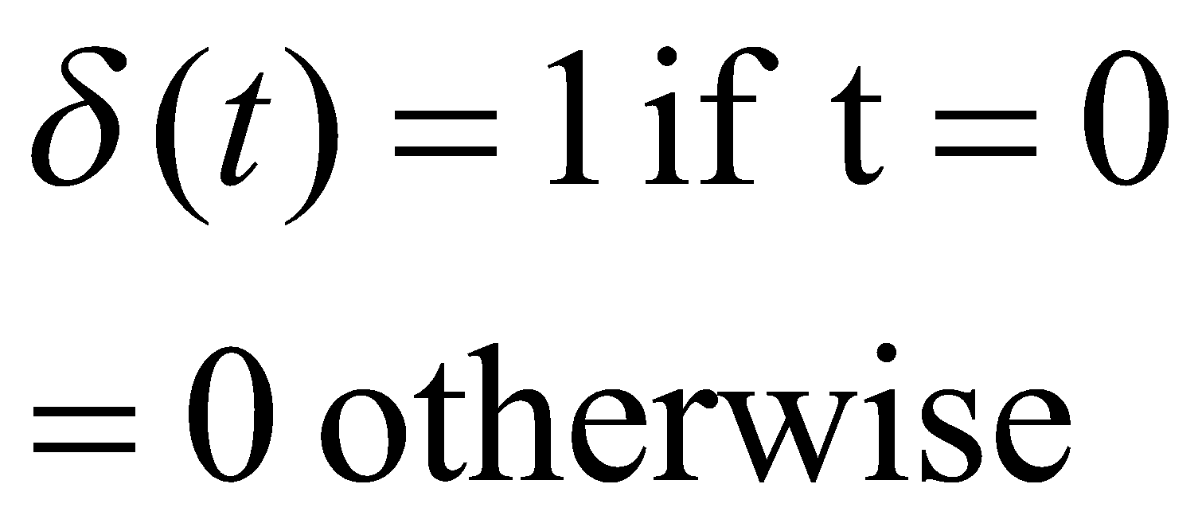
Example 2: Delta Functions
Sifting property:
Note the Dirac delta function is defined when the time variable t is continuous.
This is different from the Kronecker delta function defined on discrete time:

Slide 18
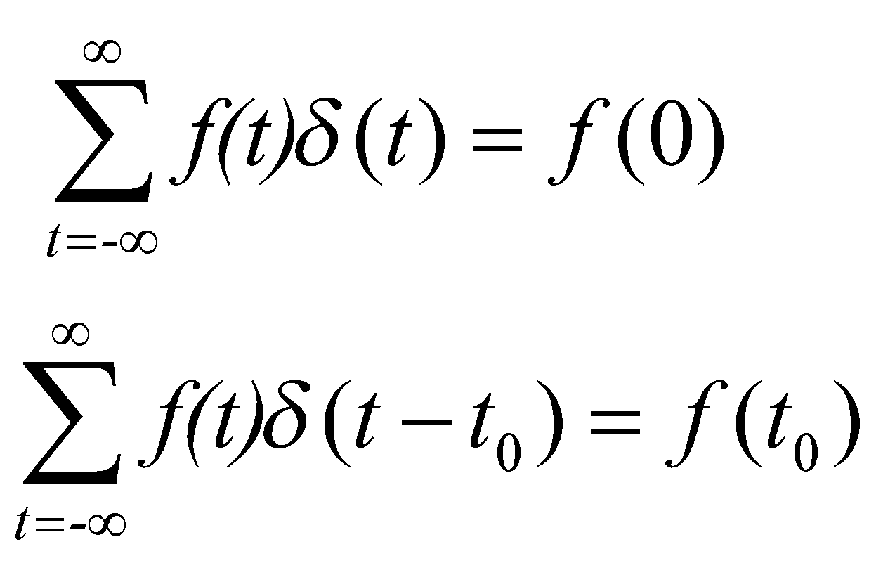
Example 2: Delta Functions
There is a sifting property for Kronecker delta functions too:

Slide 19
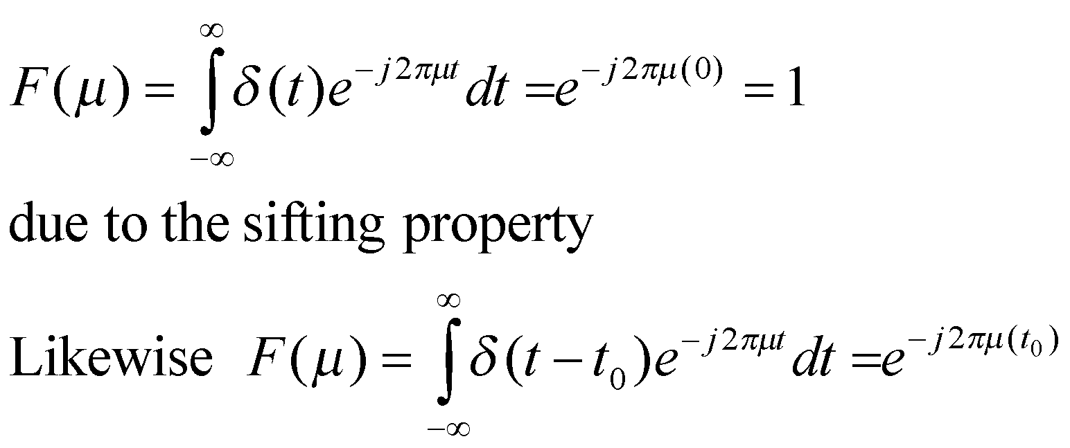
Example 2: Delta Functions
Fourier transform of the Dirac Delta Function:

Slide 20
Example 3
The figures on the next slide provide a visual illustration how the Fourier transform measures whether a frequency is present in a particular function.
The depicted function f (t) = cos(6πt) e^{−πt*t} oscillates at 3 Hz (if t measures seconds) and tends quickly to 0. (The second factor in this equation is an envelope function that shapes the continuous sinusoid into a short pulse. Its general form is a Gaussian function). This function was specially chosen to have a real Fourier transform that can be easily plotted.
The first image contains its graph. In order to calculate the transform at the frequency 3 we must integrate e^{−2πi(3t)}f (t).
The second image shows the plot of the real and imaginary parts of this function. The real part of the integrand is almost always positive, because when f (t) is negative, the real part of e^{−2πi(3t)} is negative as well. Because they oscillate at the same rate, when f (t) is positive, so is the real part of e^{−2πi(3t)}. The result is that when you integrate the real part of the integrand you get a relatively large number (in this case 1/2).
On the other hand, when you try to measure a frequency that is not present, as in the case when we look at a frequency of 5 , you see that both real and imaginary component of this function vary rapidly between positive and negative values, as plotted in the third image. Therefore, in this case, the integrand oscillates fast enough so that the integral is very small and the value for the Fourier transform for that frequency is nearly zero.
https://en.wikipedia.org/wiki/Fourier_transform (see under “Example”)

Slide 21
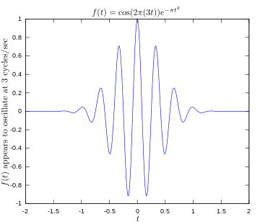
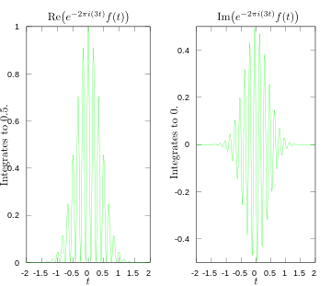
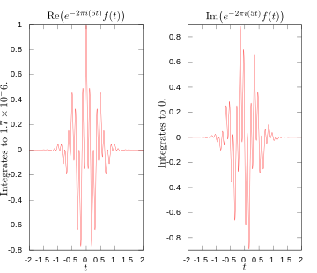
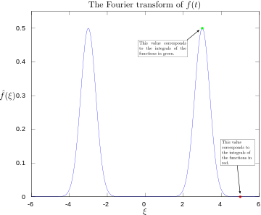
https://en.wikipedia.org/wiki/Fourier_transform

Slide 22
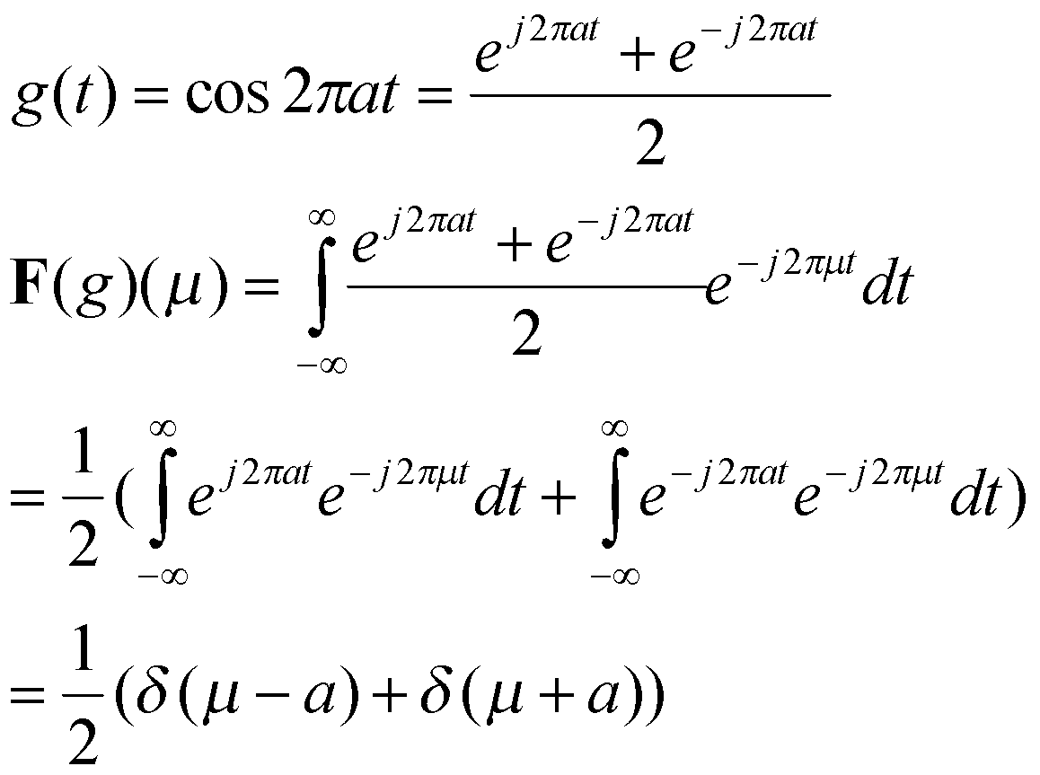
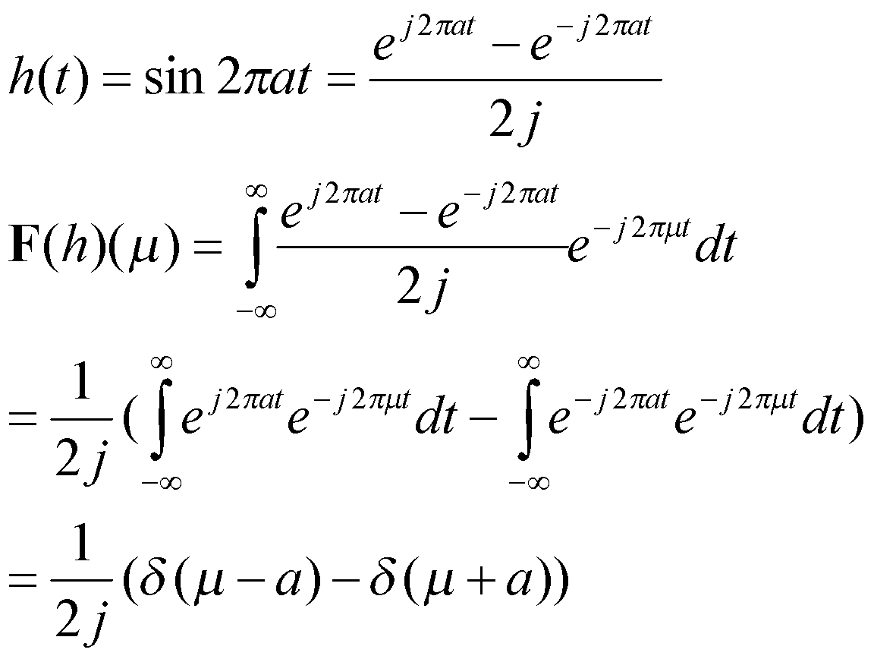
Example 4: Cosine and Sine Waves
In both cases, these are Dirac delta (and not Kronecker delta) functions.

Slide 23
Fourier Transform
In general, the Fourier transform of a real-valued signal yields complex-valued Fourier coefficients.
Just like a Fourier series, it allows for complete signal recovery.
Unlike a Fourier series, it allows for non-periodic signals and also allows for the frequencies to be non-integer (real-valued).

Slide 24
Fourier Transform and Music
Audio/music signals are recorded in the time domain.
However the different musical notes are represented by fundamental frequencies (eg: the note C#, typical scale of male vocalists, is 138.59 Hz; the scale of a typical female vocalist is 246.94 Hz).
Fourier transform allows for identification of the musical notes within the audio signal.
A musical note sung or played is never just a single frequency - it contains many frequencies (overtones) but the amplitude is the highest at its fundamental frequency.

Slide 25
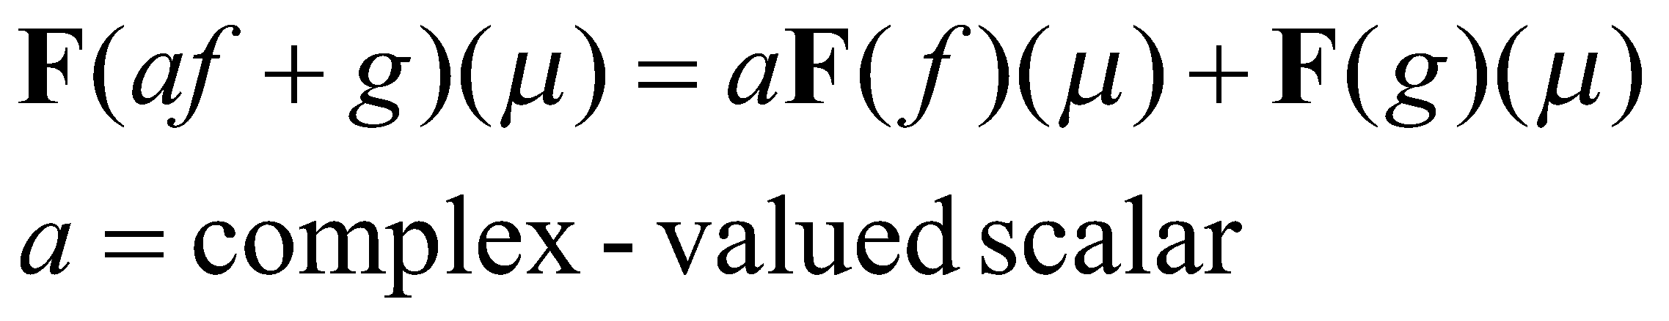
Properties of the Fourier Transform
Linearity
This follows from the definition of the Fourier transform.
Is it shift invariant?

Slide 26
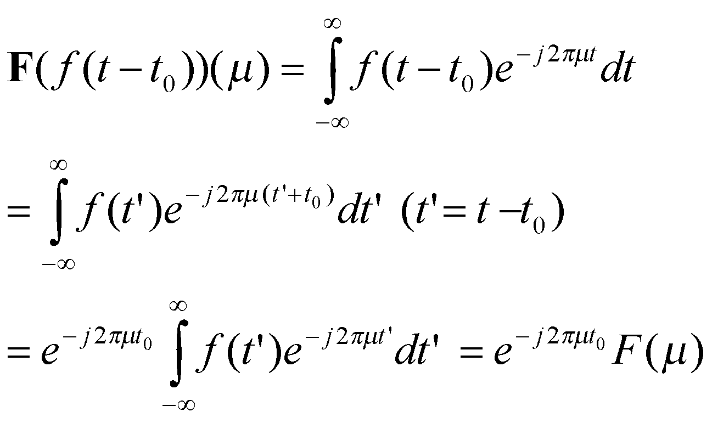
Properties of the Fourier Transform
Is it shift invariant?
The Fourier transform of a signal f shifted by time t₀ is equal to the Fourier transform of the original signal f but multiplied by a phase factor dependent on t₀. This is called the Fourier shift theorem.

Slide 27
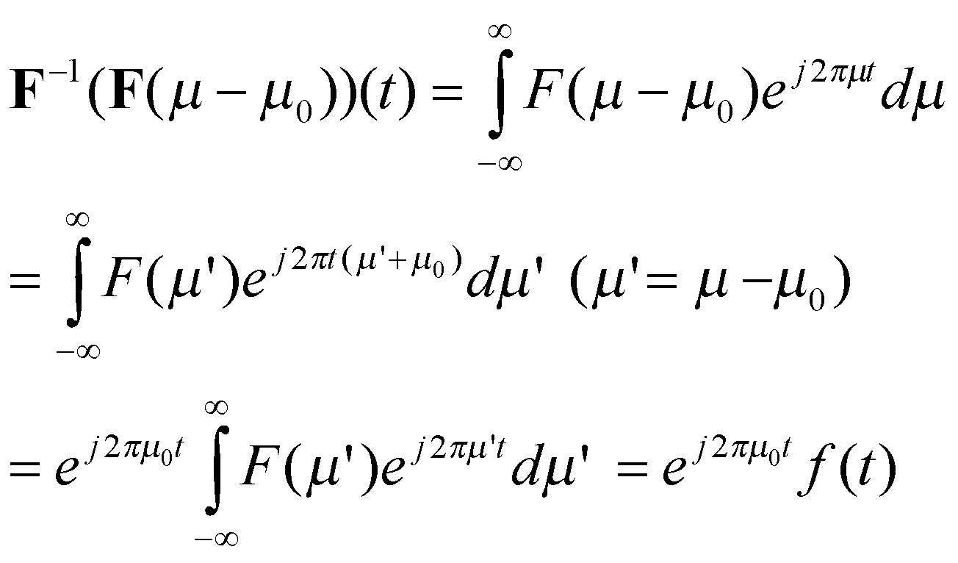
Properties of the Fourier Transform
A variant of the Fourier shift theorem:
Translation in the Fourier space by a factor 𝜇₀ is equivalent to modulation of the original signal by a phase factor which depends on 𝜇₀.

Slide 28
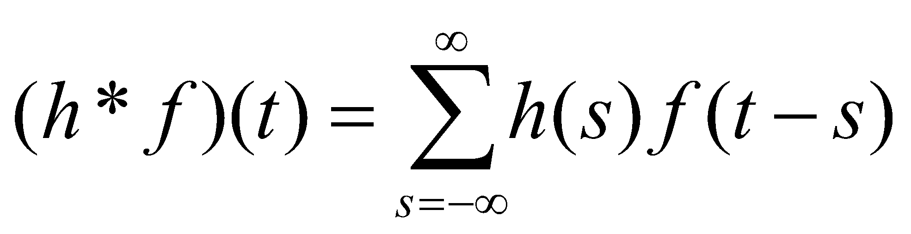
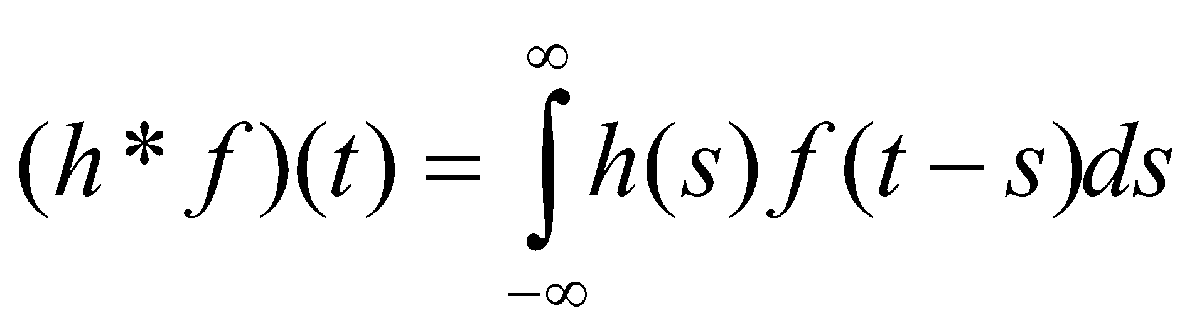
Properties of the Fourier Transform: Convolution Theorem
Concept of convolution: we have seen the convolution in the discrete setting.
Recall:
The convolution is defined in the case of continuous signals as follows:

Slide 29
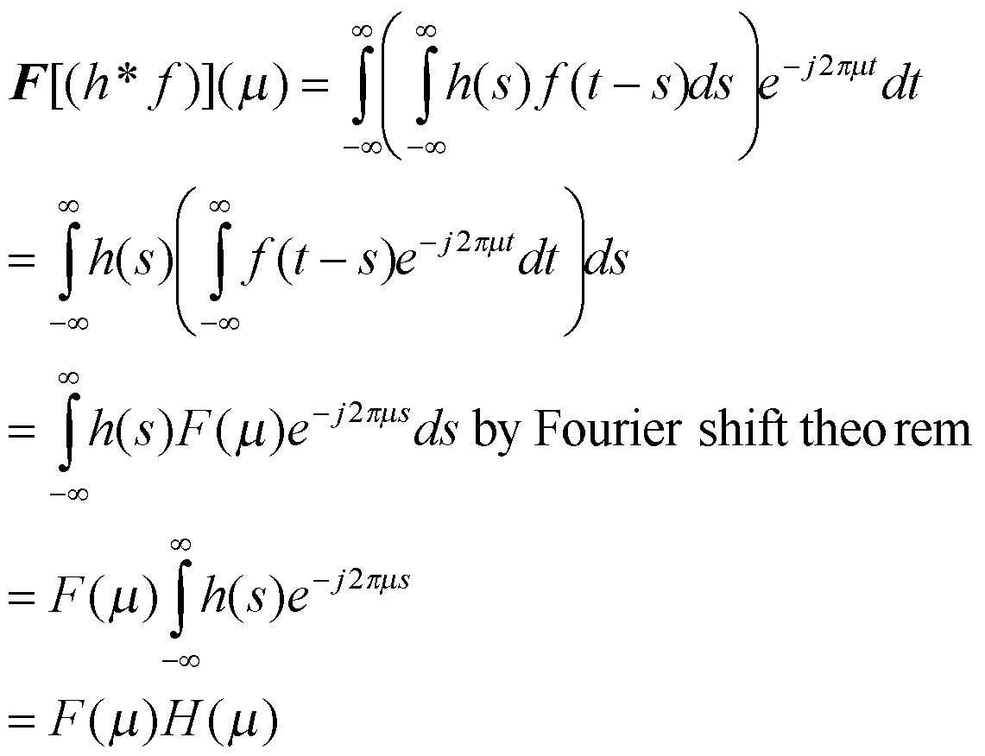
Properties of the Fourier Transform: Convolution Theorem
The Fourier transform of the convolution is given as follows:

Slide 30
Properties of the Fourier Transform: Convolution Theorem
Theorem: The Fourier transform (for frequency µ) of the convolution of two signals is given by the product of their Fourier transforms at the same frequency.
This is an extremely important theorem in signal processing. It is called the convolution theorem.
It will be very useful in Fourier-based filtering.

Slide 31
Variant of the convolution theorem
The Fourier transform of the point-wise multiplication of two signals at frequency µ is equal to the convolution of their respective Fourier transforms, evaluated at frequency µ.

Slide 32
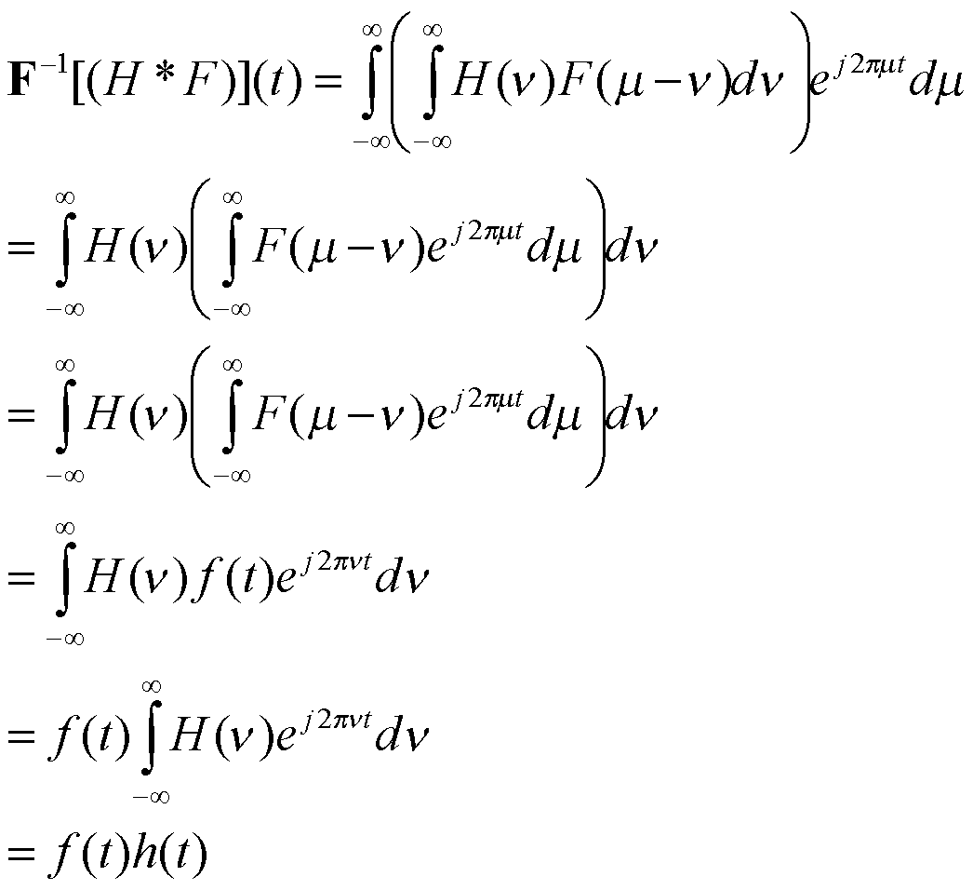

Slide 33
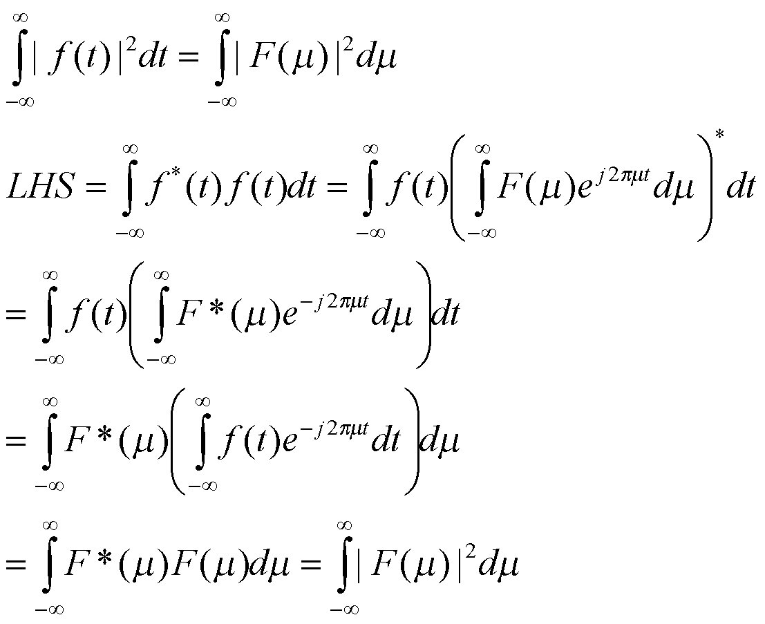
Properties of the Fourier Transform: Parseval’s theorem

Slide 34
Properties of the Fourier Transform: Parseval’s theorem
Parseval’s theorem has interesting implications in image compression – which we will study later.

Slide 35
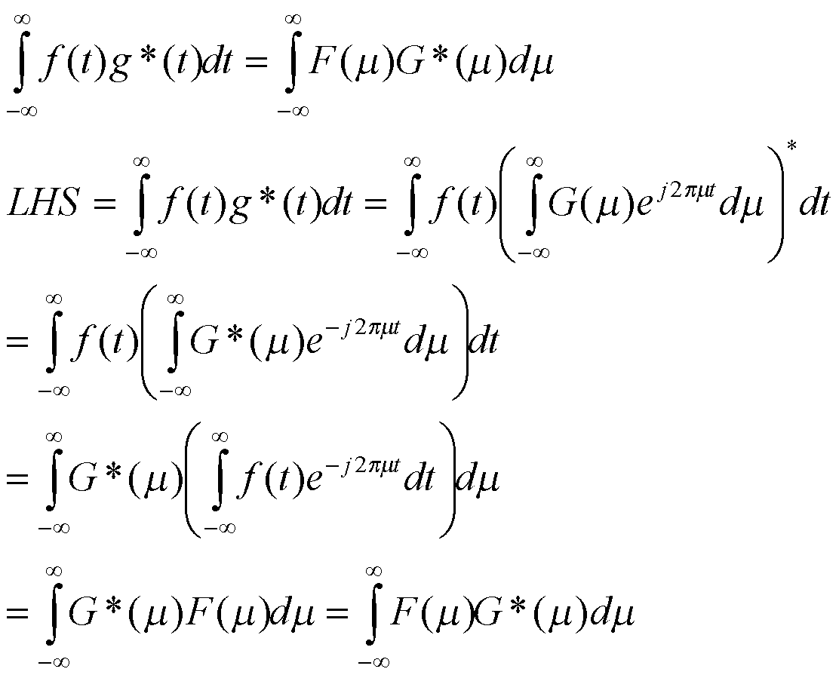
Properties of the Fourier Transform: Parseval’s theorem (variant)
This variant is more general than the earlier one, which assumed f(t) = g(t).

Slide 36
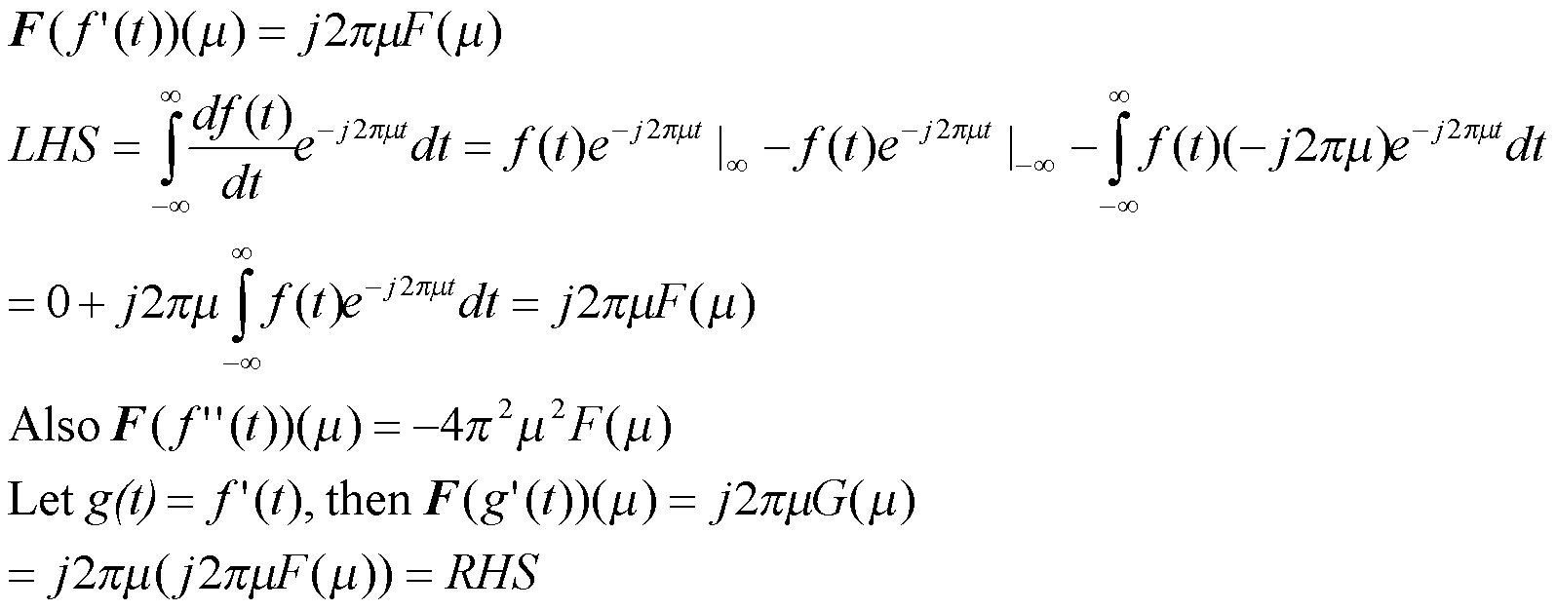
Properties of the Fourier transform: Differentiation theorem
For a differentiable function f(t), we have:
Using integration by parts
This assumes that the function is twice differentiable
Here we are assuming that f and f’ are both integrable. This property is useful in solving partial differential equations because derivatives get turned into simple products.

Slide 37
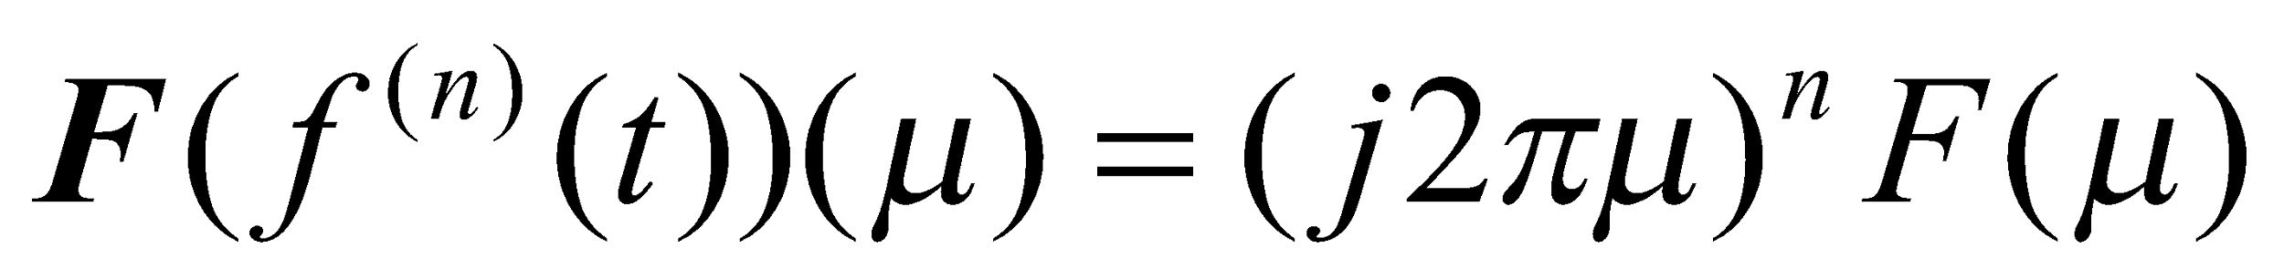
Properties of the Fourier transform: Differentiation theorem
Continuing this derivation recursively further for a n-times differentiable function f(t), we have:

Slide 38
Time-limited and band-limited signals
A signal is said to be time-limited if it is of finite duration.
A signal is said to be band-limited if for every frequency |µ| > B (where ∞ > B >= 0), we have F(µ) = 0.
Any signal stored in a digital computer will always be time-limited (this will later extend to 2D images which are space-limited as they have a finite extent in the XY space).

Slide 39
Time-limited and band-limited signals
(1) A non-zero time-limited signal cannot be band-limited.
(2) A non-zero band-limited signal cannot be time-limited.
To some extent, we have observed this via pairs as the rect and sinc, Dirac impulse and uniform signal. We will now prove it.

Slide 40
Time-limited and band-limited signals
(1) A non-zero time-limited signal cannot be band-limited.
Proof:
Let us assume a time-limited signal g(t) which is zero everywhere for |t| > W/2.
Then we can write g(t) = g(t).rect(t;W/2).
Then taking Fourier transform on both sides, we have G(µ)=G(µ)*Wsinc(Wµ).
As the sinc function never completely goes to zero, G cannot have finite support in the frequency domain, so g cannot be band-limited.
A detailed proof, especially illustrating the last point above is here.

Slide 41
Time-limited and band-limited signals
(2) A non-zero band-limited signal cannot be time-limited.
Proof:
Let us assume a band-limited signal h(t). Its Fourier transform H(µ) is zero everywhere for |µ| > B/2.
Then we can write H(µ) = H(µ).rect(µ;B/2).
Then taking inverse Fourier transform on both sides, we have h(t)=h(t)*Bsinc(Bt).
As the sinc function never completely goes to zero, h cannot have finite support in the time domain, so h cannot be time-limited.

Slide 42
Time-limited and band-limited signals
We already know that for any signal h, we must have h(t) = (h*δ)(t) where δ is the Dirac delta function.
But the earlier proof tells us that for a band-limited signal h(t), we also have h(t)=h(t)*Bsinc(Bt)!

Slide 43
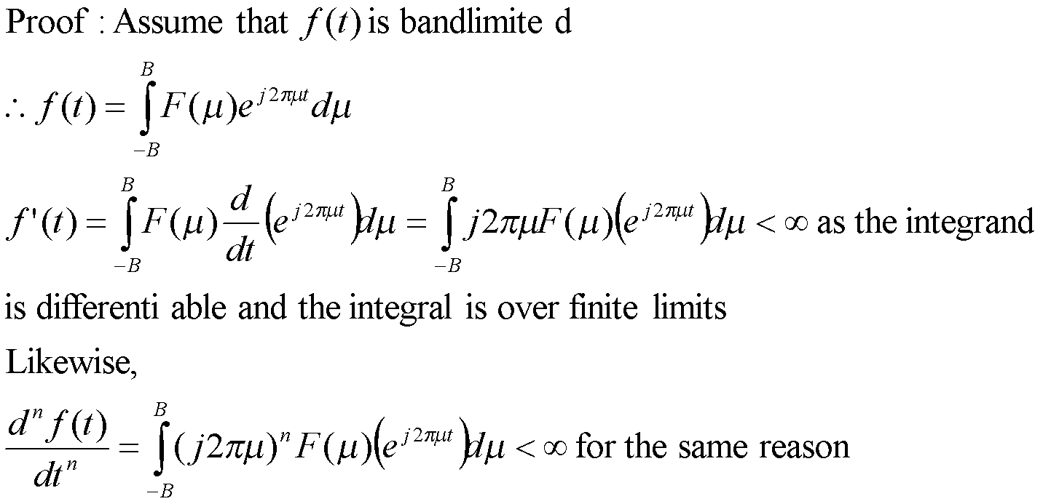
Time-limited and band-limited signals
A band-limited signal is infinitely differentiable (converse is not true – eg: Gaussian).

Slide 44
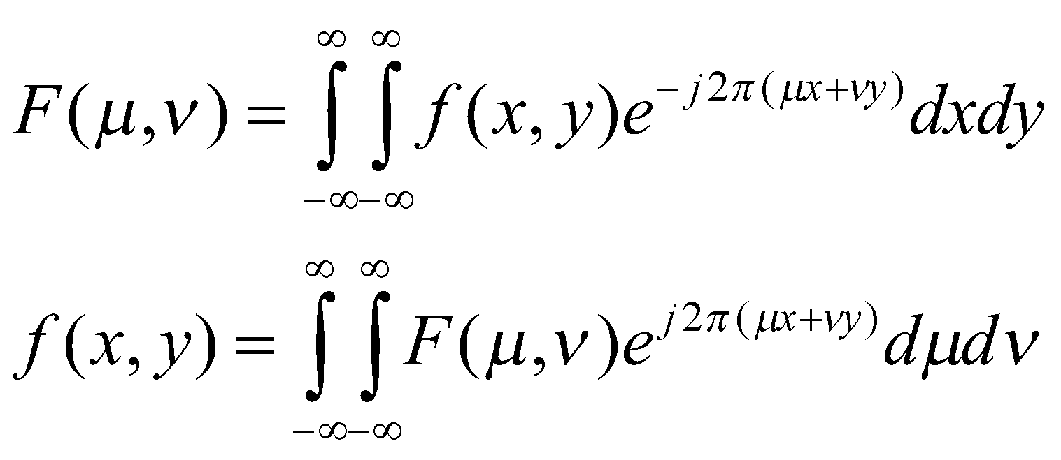
Fourier Transforms in 2D
Fourier Transforms and its inverse in 2D – spatial coordinates (x,y) and frequency coordinates (µ,ν).
In fact, such pairs exist in higher dimensions (3,4,…) as well.

Slide 45
Fourier Transforms in 2D
All aforementioned theorems hold in higher dimensions too: shift theorem, convolution theorem, Parseval’s theorem, and others.
The higher dimensional Fourier transform has the property of separability.
That is a 2D Fourier transform is obtained as follows:
For every x, compute the 1D Fourier transform of f(x,.) integrating across y to produce a signal F(x,ν).
Then compute the 1D Fourier transform of F(.,ν) by integrating across x to get F(µ,ν).

Slide 46
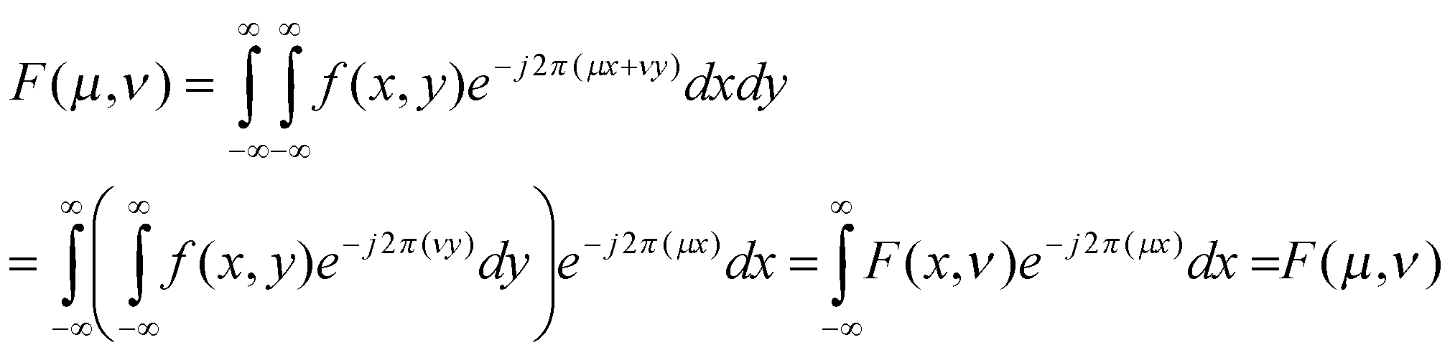
1D Fourier Transforms
2D Fourier transforms are said to be separable as they are computed by 1D Fourier transforms in each of the coordinates. You may verify that the separability property holds true even for inverse Fourier transforms in 2D.

